Slide 1

GBFS O/D Inference
Hannah DeBruin
Weekly Meeting: Transit Data Subgroup
11/09/22

Slide 2
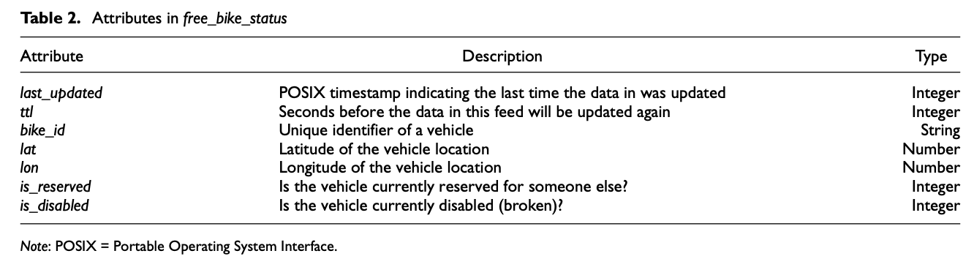
How GBFS Works
When vehicles are available, they show up with the following attributes:
This data updates with every data-update delay interval (”Time to Live” or TTL)
No specific value is required, varies by vendors from 0 (always refreshed) to 600 seconds
Weekly Meeting (11/09/2022)
Hannah DeBruin

Slide 3
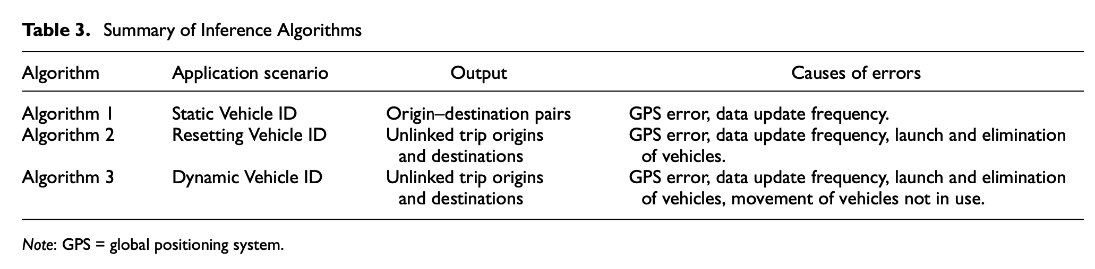
Types of Vehicle IDs
Past inference of O/D of scooter trips has relied upon Static Vehicle ID.
Static Vehicle ID never changes
Resetting Vehicle ID leaves the GBFS as one ID when trip starts and returns as a different ID when trip ends
Dynamic Vehicle ID is reset after a certain amount of time, greater than the TTL (usually every thirty minutes)
2022 Xu et al developed algorithms for two other common types of vehicle ID
Weekly Meeting (11/09/2022)
Hannah DeBruin

Slide 4
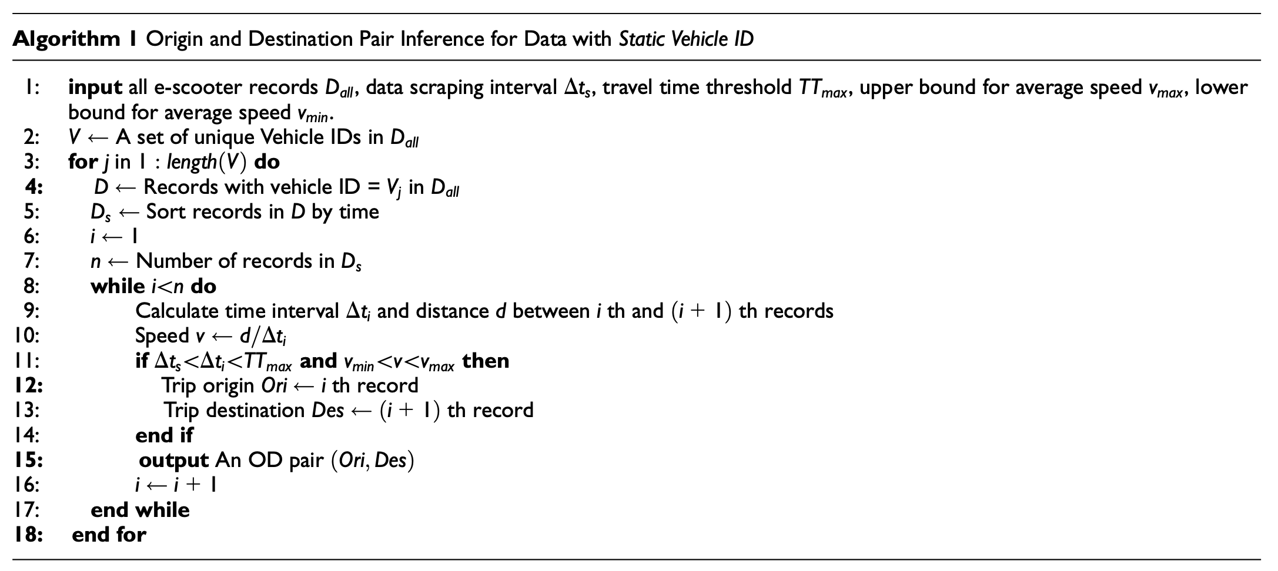
Algorithm 1 (Static ID)
Take all records with a specified vehicle ID, sort them by time, calculate the time interval and distance between sequential records, ensure that the time interval is between the data scraping interval and travel time threshold, ensure that the speed is between the minimum and maximum possible vehicle speeds, then return the OD pair
Weekly Meeting (11/09/2022)
Hannah DeBruin

Slide 5
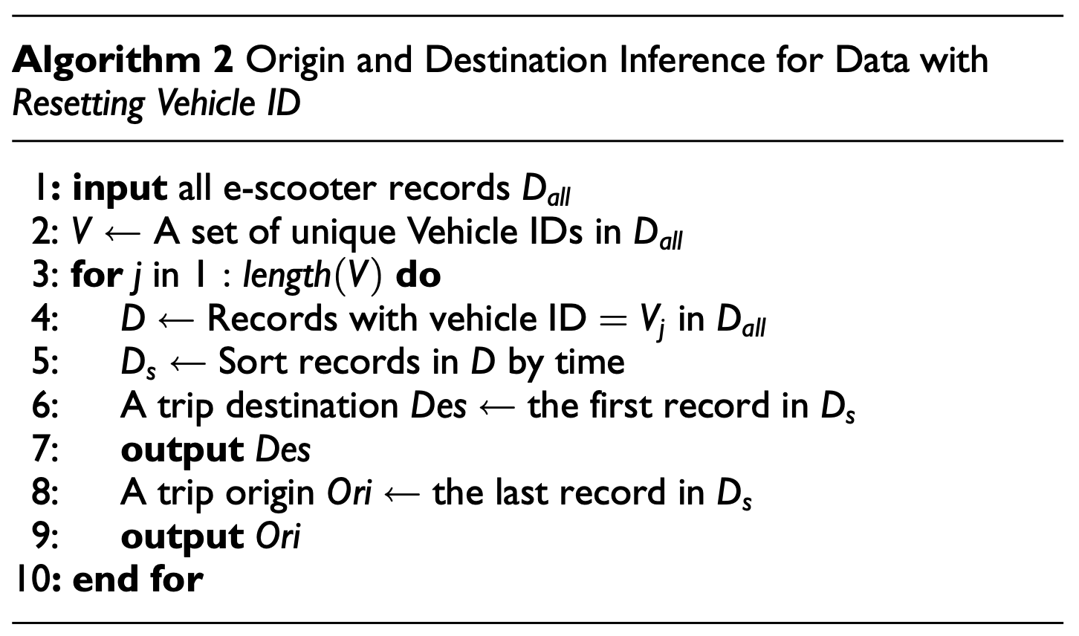
Algorithm 2 (Resetting ID)
Look at all records with the same vehicle ID, sort them by time, the first record of that vehicle ID is a destination, and the last record of that vehicle ID is an origin.
(Basically, we evaluate when the scooter is waiting for some to start a trip and when it is finished waiting)
Note: this origin point and destination point cannot be linked together
Potential Error: if new scooters are launched this algorithm IDs them as a destination, if broken scooters are eliminated, this algorithm IDs them as an origin
Weekly Meeting (11/09/2022)
Hannah DeBruin

Slide 6
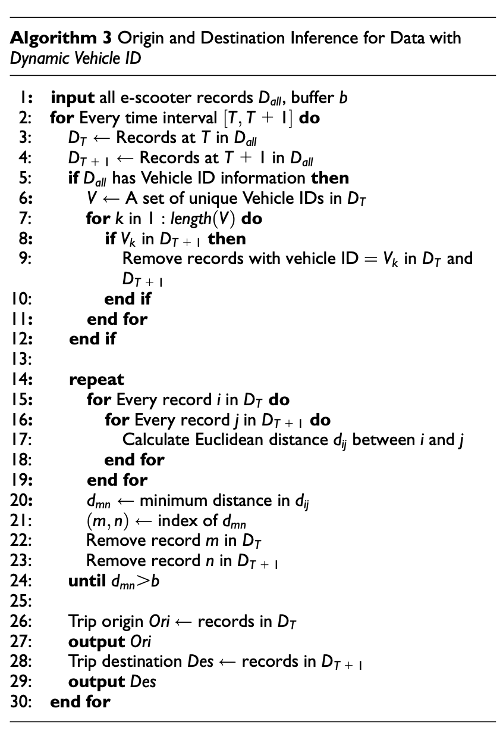
Algorithm 3 (Dynamic ID)
Look at all records at a specified time and at a specified time one data-scraping interval in the future. If a unique vehicle ID is identified to be in both times, then remove the records of that ID in both sets. For each record left, calculate the Euclidean distance between the potential initial position and potential final position, creating a matrix of potential distances. Select the minimum distance from that matrix and remove the potential starting point and potential ending point record that caused that minimum. Repeat this until the minimum distance identified is greater that the input buffer distance.
The leftover potential initial positions are reported as origins and the leftover final positions are reported as destinations
This is repeated for every time.
Note: this origin point and destination point cannot be linked together
Potential Error: rebalancing trips may be recognized as trips
Weekly Meeting (11/09/2022)
Hannah DeBruin

Slide 7
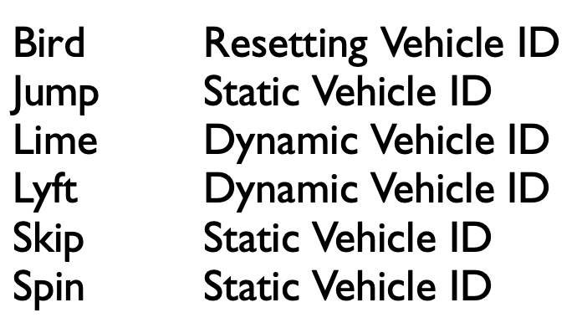
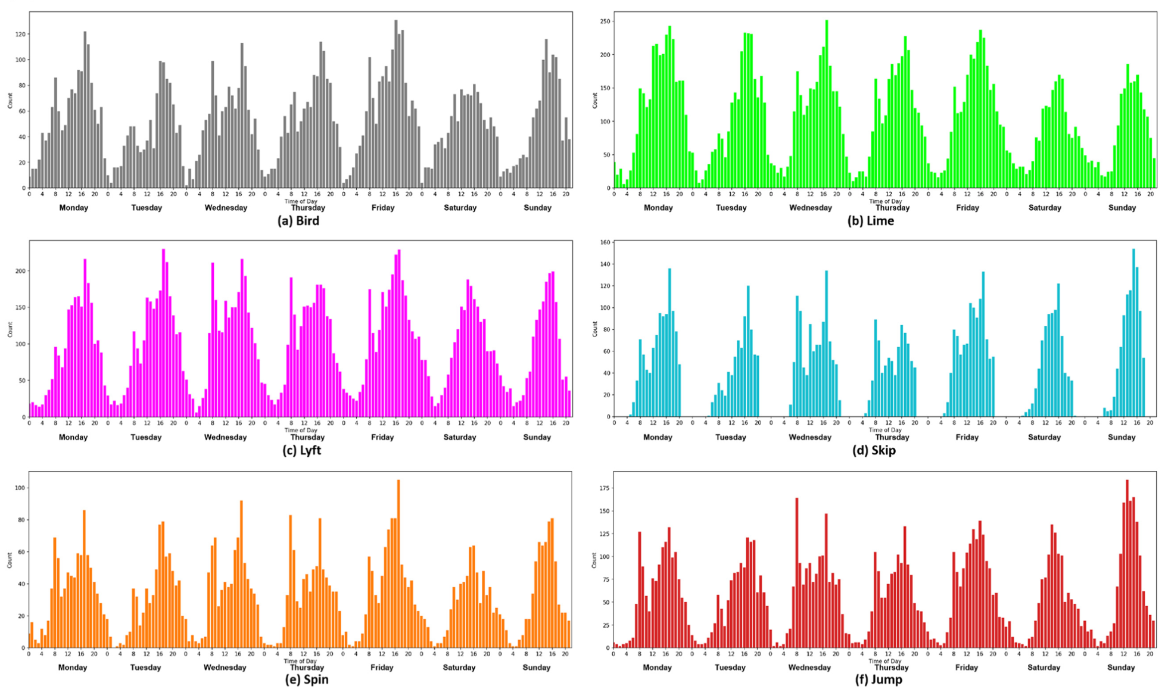
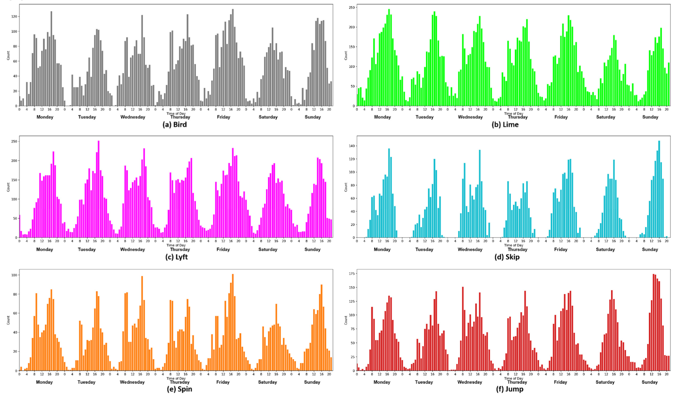
Results – Washington DC
Trip Origins
Trip Destinations
Weekly Meeting (11/09/2022)
Hannah DeBruin

Slide 8
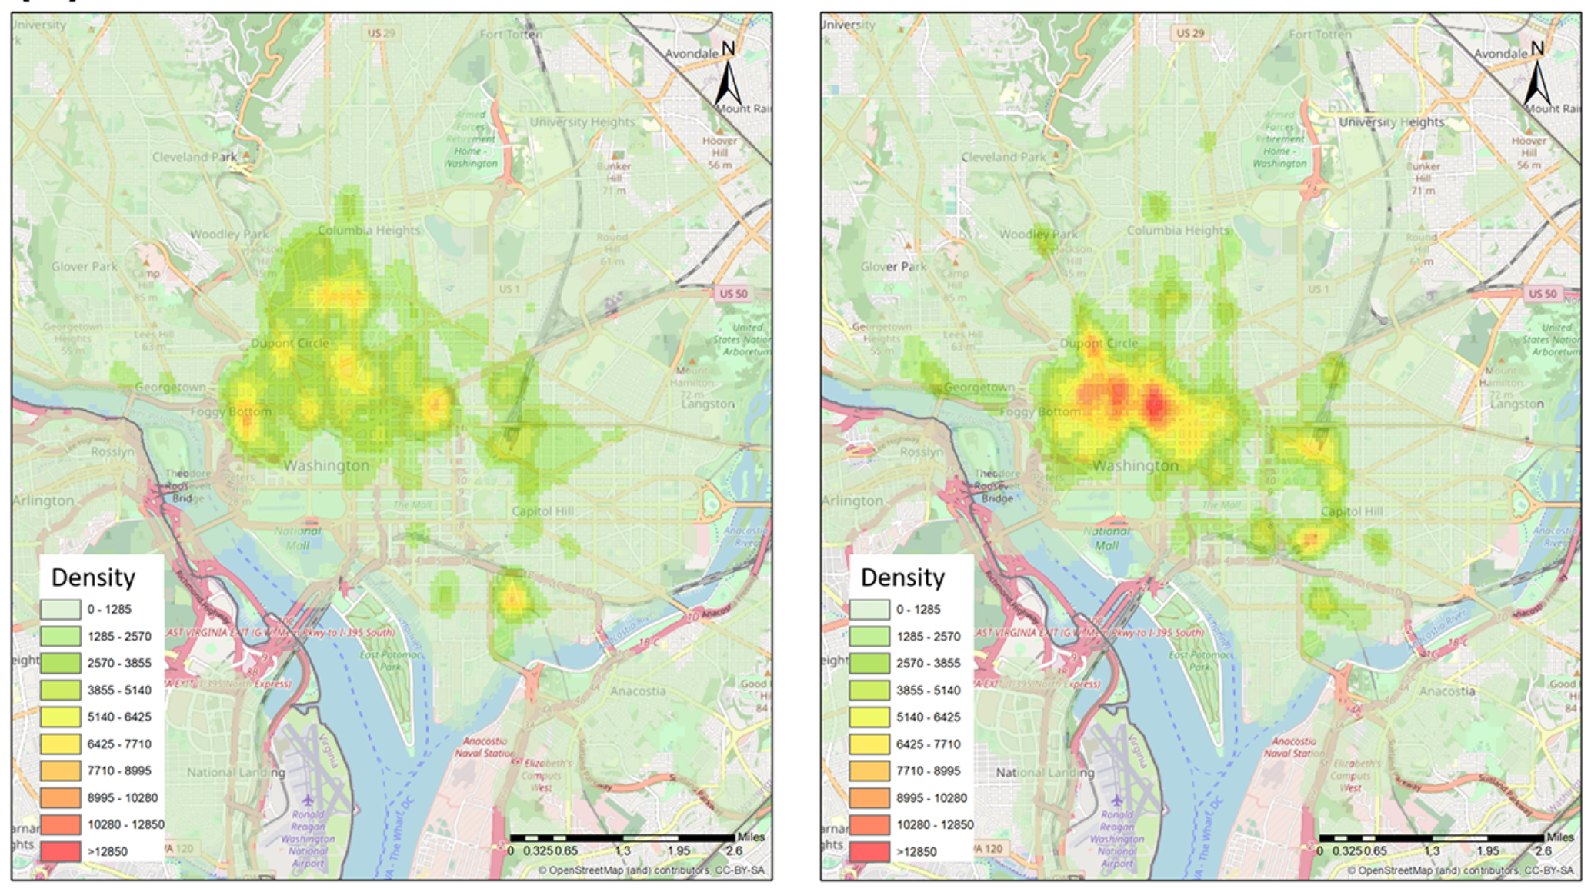
Results – Washington DC
AM - Trip Origins
AM - Trip Destinations
Weekly Meeting (11/09/2022)
Hannah DeBruin

Slide 9
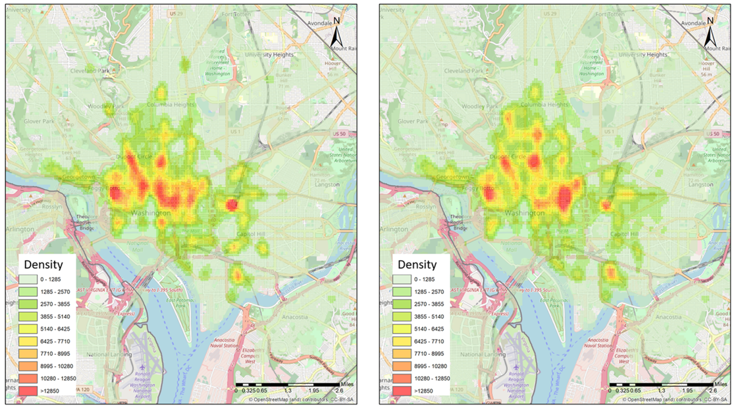
Results – Washington DC
PM - Trip Origins
PM - Trip Destinations
Weekly Meeting (11/09/2022)
Hannah DeBruin

Slide 10
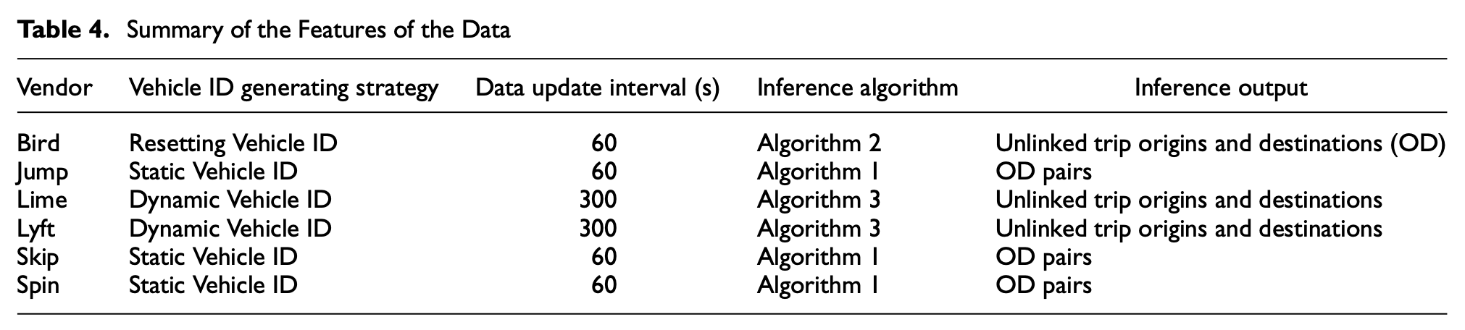
Evaluation of Algorithms
Algorithm 1 was run on Jump scooters’ static vehicle ID to find O/D pairs, and this was used as ground truth.
Jump records were reformulated as Resetting Vehicle ID and Dynamic Vehicle ID circumstances, and Algorithms
2 and 3 were evaluated using this data.
Weekly Meeting (11/09/2022)
Hannah DeBruin

Slide 11
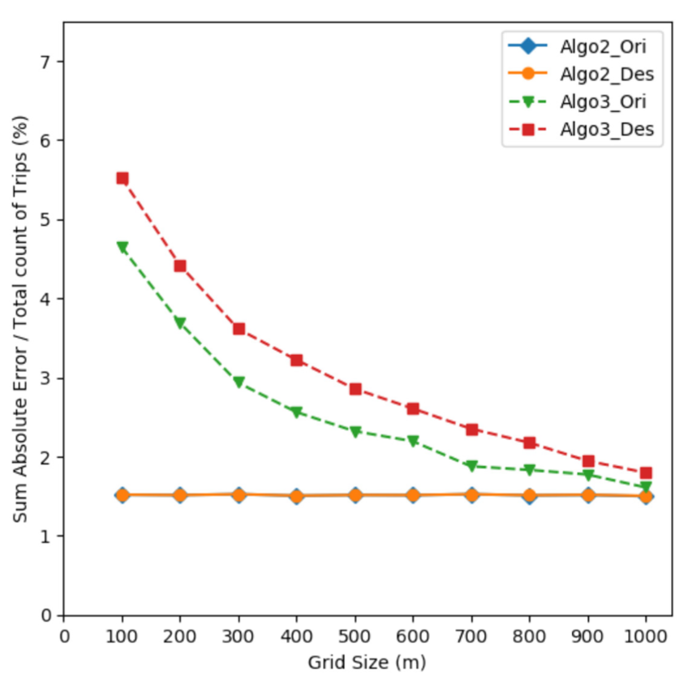
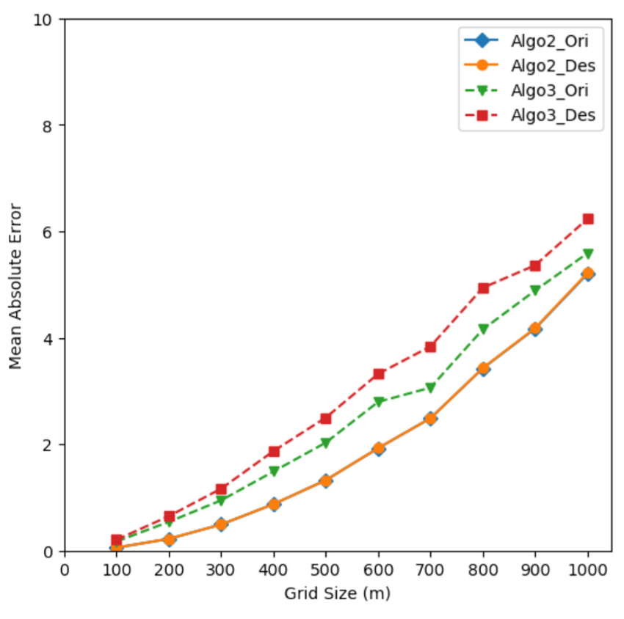
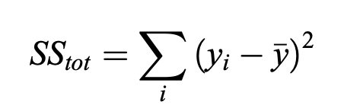
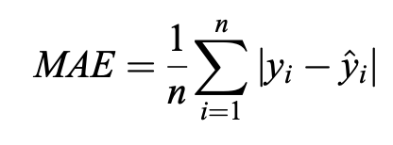
Evaluation of Algorithms
Sum Square Error
Mean Absolute Error
Weekly Meeting (11/09/2022)
Hannah DeBruin

Slide 12
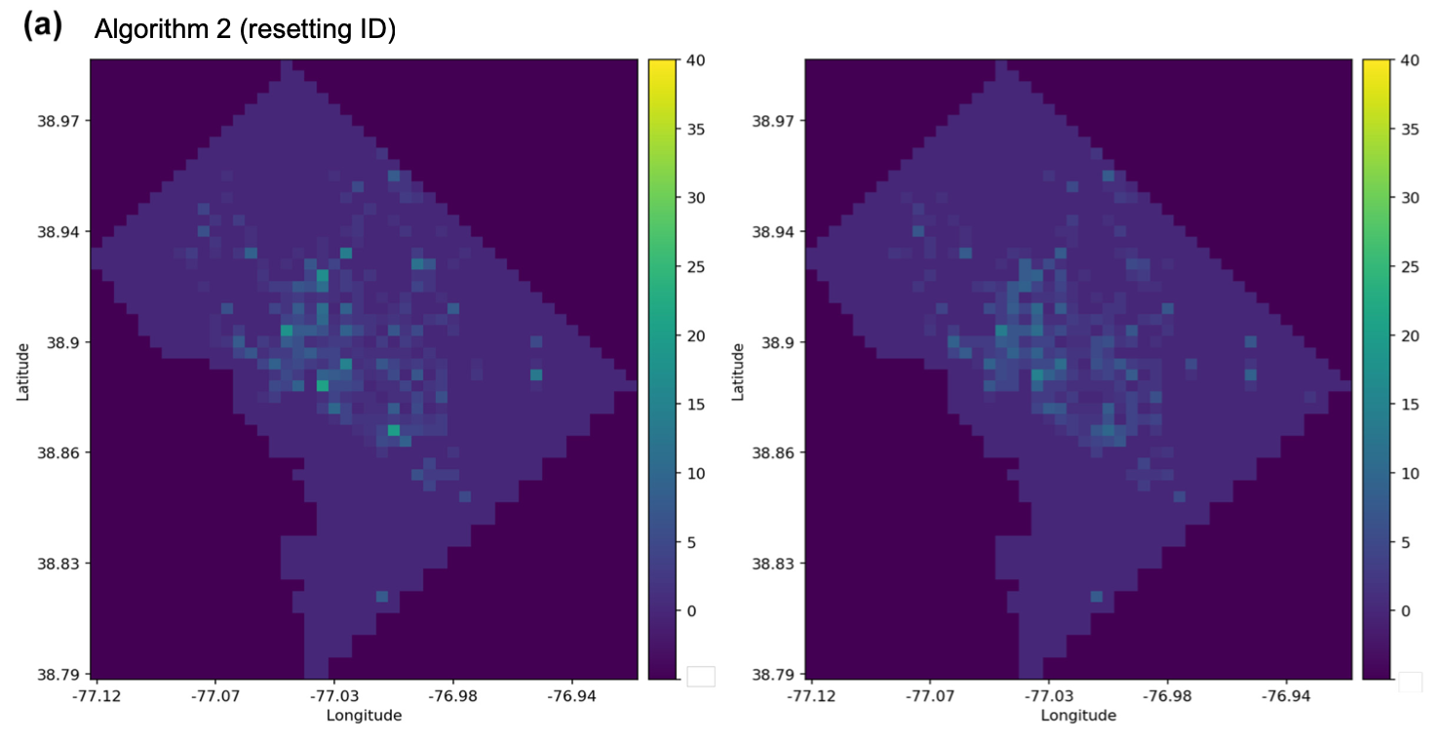
Evaluation of Algorithms
Origin
Destination
(absolute value inference error)
Weekly Meeting (11/09/2022)
Hannah DeBruin

Slide 13
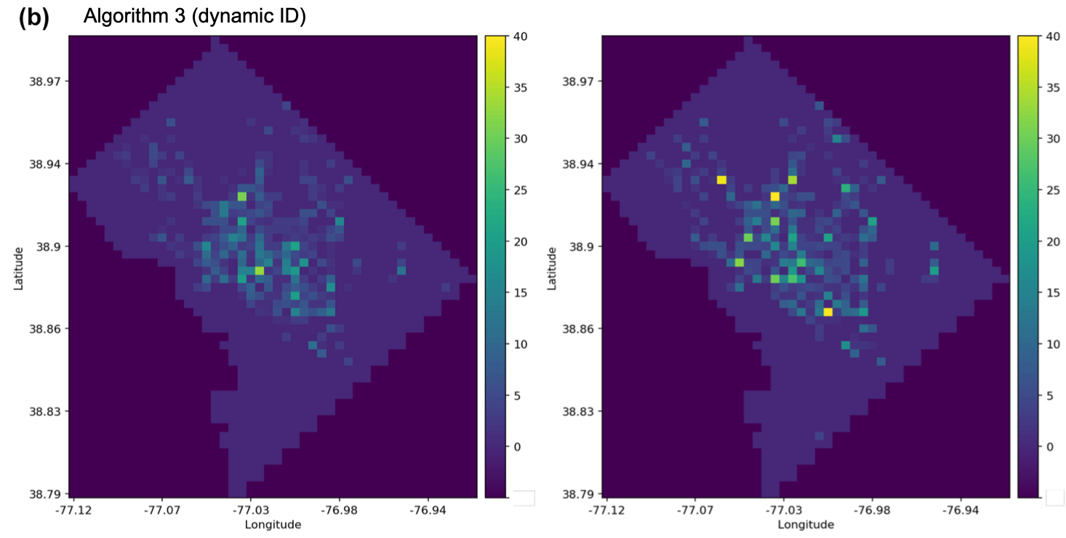
Evaluation of Algorithms
Origin
Destination
(absolute value inference error)
Weekly Meeting (11/09/2022)
Hannah DeBruin

Slide 14
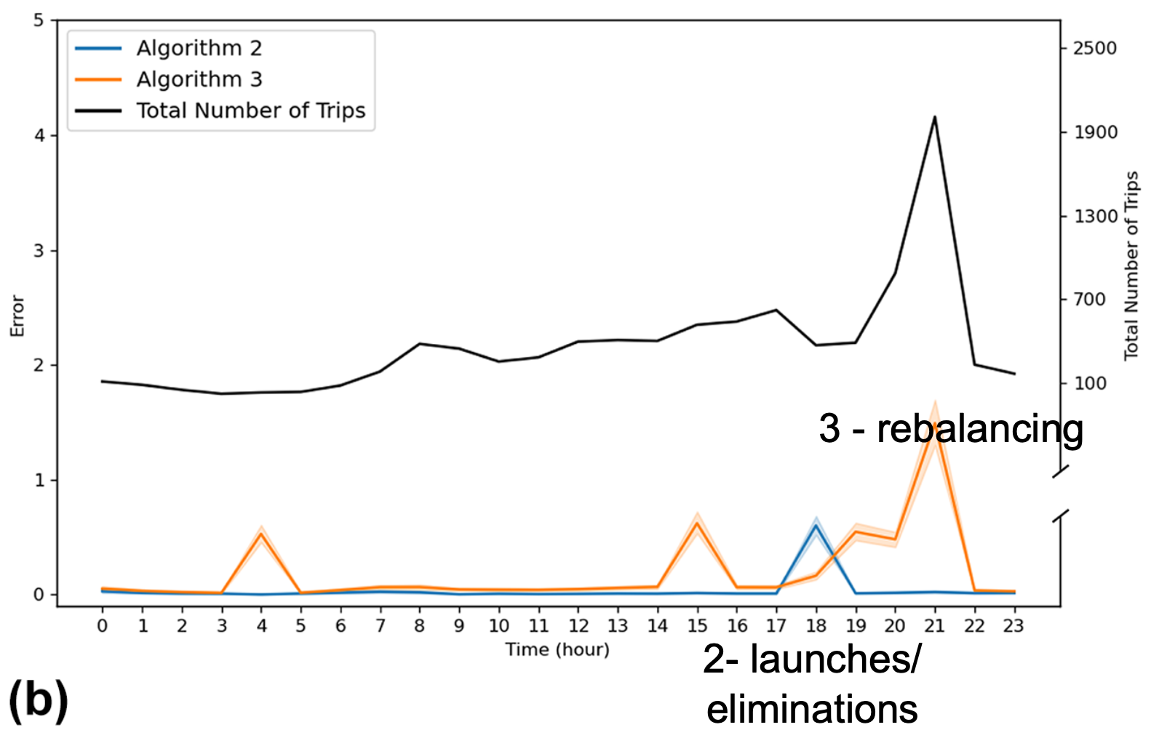
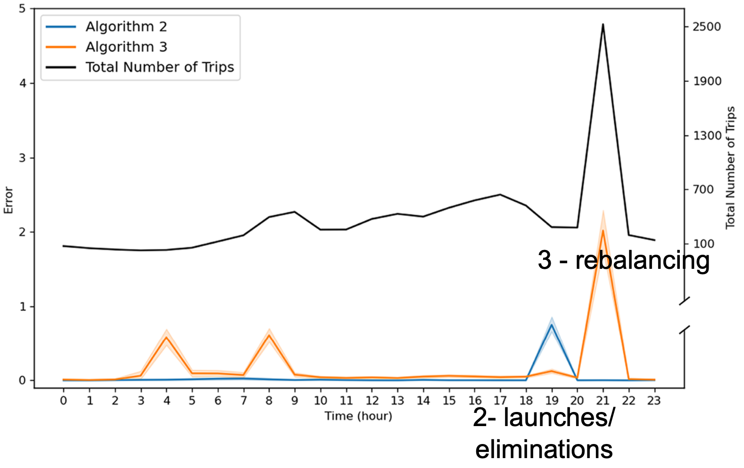
Evaluation of Algorithms
Origin
Destination
(absolute value inference error)
Weekly Meeting (11/09/2022)
Hannah DeBruin

Slide 15
Future Improvement
“Future work may consider developing optimization algorithms to infer OD pairs from the separate trip origins and destinations (40, 41). Moreover, future work may also include investigating the e-scooter trip purpose by intersecting the trip inference results with the land use data. As the number of entities sharing GBFS increases, researchers may examine how the GBFS data and the algorithms developed for them such as the ones we pres- ent here have been instrumental for transportation decision-making.”
Weekly Meeting (11/09/2022)
Hannah DeBruin

Slide 16

Contactless Fare Payment Resource from CTS Conference
Surveyed Greater Minnesota (outside of the Twin Cities) on attitudes about returning to shared mobility (mostly ridehailing from my understanding) after the peak pandemic, specifically studying which safety measures attracted riders and which safety measures would discourage ridership, had one question about contactless fare payment
Socio-Demographic analysis was performed to find some interesting results (ie unvaccinated people were less likely to use shared mobility services if there were any safety measures implemented)
Weekly Meeting (11/09/2022)
Hannah DeBruin

